Slide 1
Chapter 4
Data Link Layer
Module 6: Data Link Layer
Introduction to Networks v7.0 (ITN)

Slide 2
Objectives
4.1 Data Link Layer Protocols
4.2 Media Access Control

Slide 3
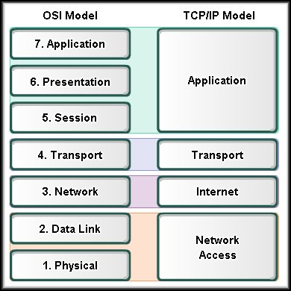
4.1 Data Link Layer Protocols

Slide 4

Basic Terms
Frame → The Data Link layer PDU
Node → The Layer 2 notation for network devices connected to a common medium
Media / medium → The physical means (connectors) for the transfer of information between two nodes, eg. Copper wire, fiber optic etc
Network → Two or more nodes connected to a common local medium

Slide 5
Roles of Data Link Layer
2 basic functions:
Allows the upper layers to access the transmission media using framing.
Controls how the frame travel across common local media → using different media access control (MAC) methods and error detection

Slide 6
Structure of Data Link Layer
The data link layer is actually divided into two sublayers:
Logical Link Control (LLC) sublayer
This upper sublayer defines the software processes that provide services to the Network Layer protocols.
Media Access Control (MAC) sublayer **
This lower sublayer defines the media access processes performed by the hardware → transmission media (hardware processes)

Slide 7
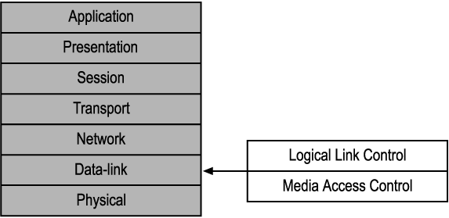

Slide 8
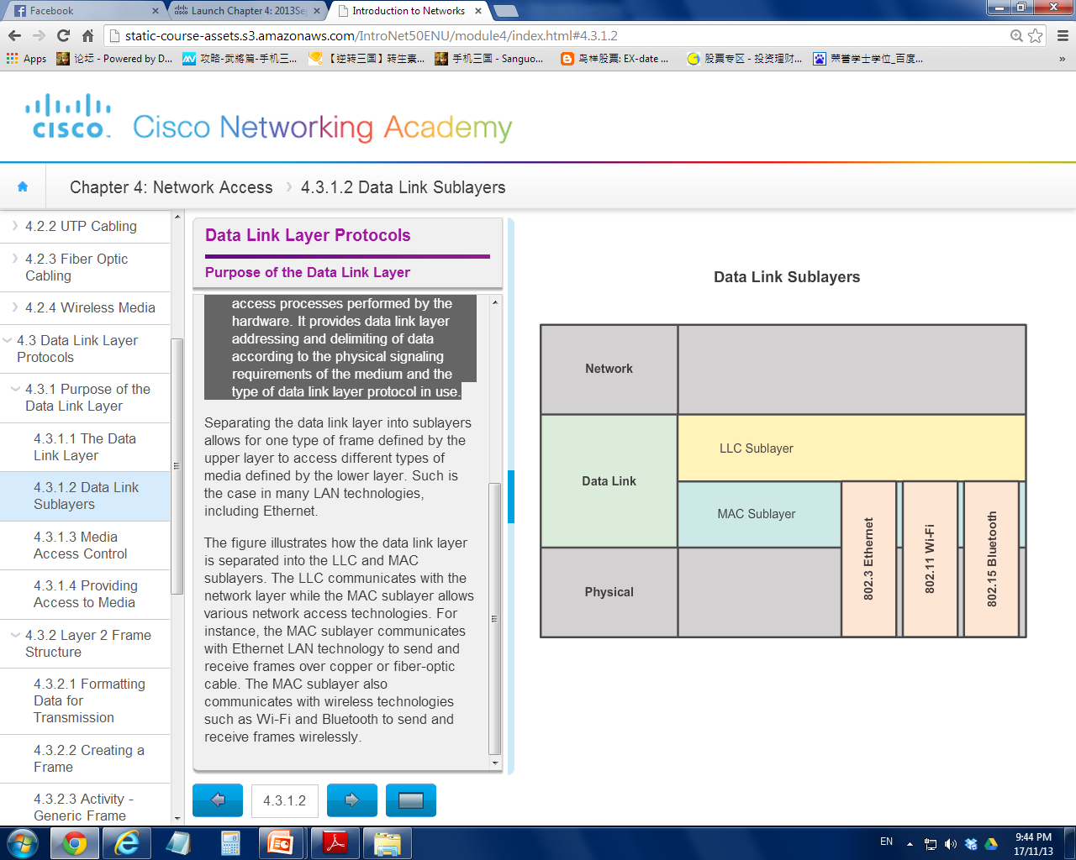

Slide 9
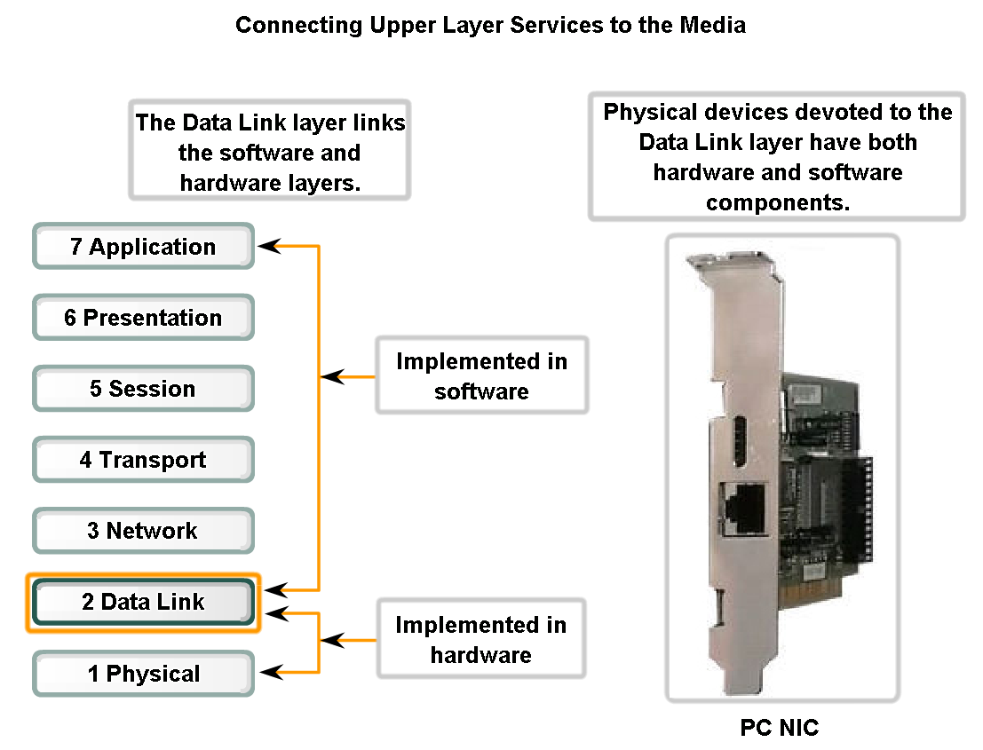
Data Link Layer prepares the packets from the upper layer software processes for transmission over the physical media.
Hence, it is known as the Connecting Layer

Slide 10
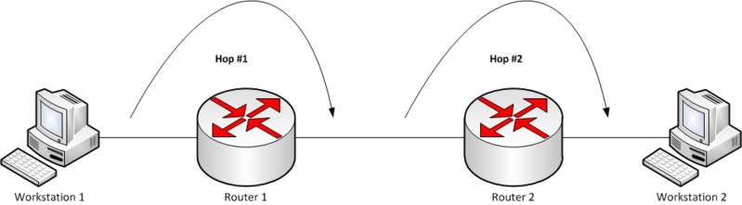
4.2 Media Access Control
When a packet travel around from networks (hopping) , it may encounter media with different characteristics
`
www.wikipedia.com

Slide 11
Cont’d…
At each hop along the path, a router:
Accepts a frame from a medium
De-encapsulates the frame
Re-encapsulates the packet into a new frame
Forwards the new frame that is appropriate to the medium of the new network
Why so hassle ?

Slide 12
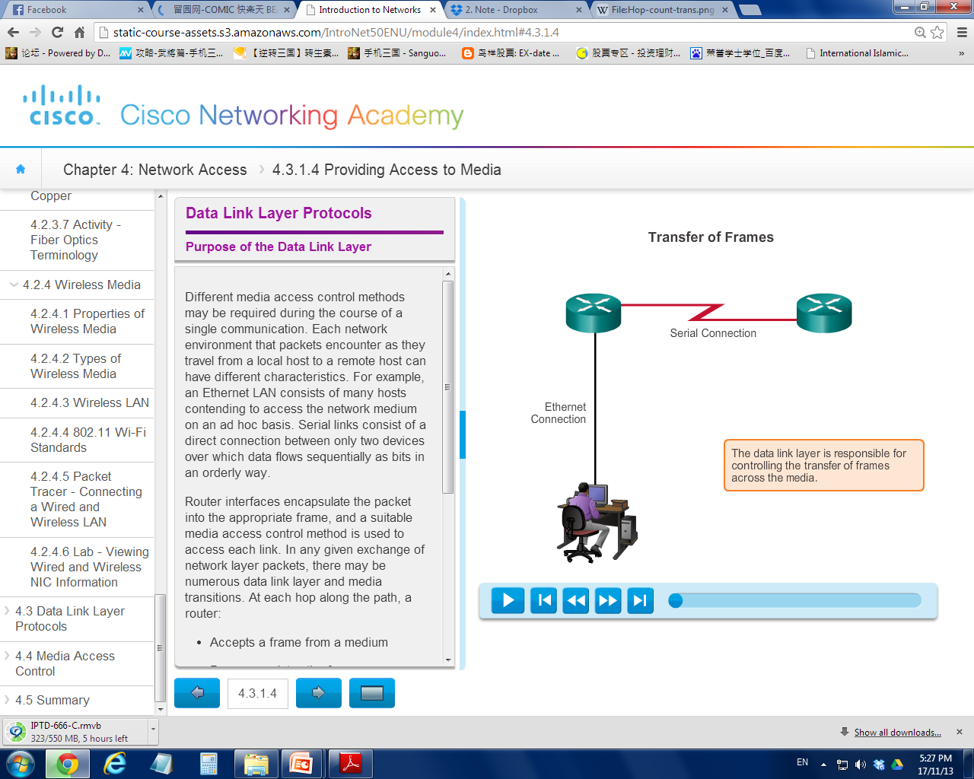
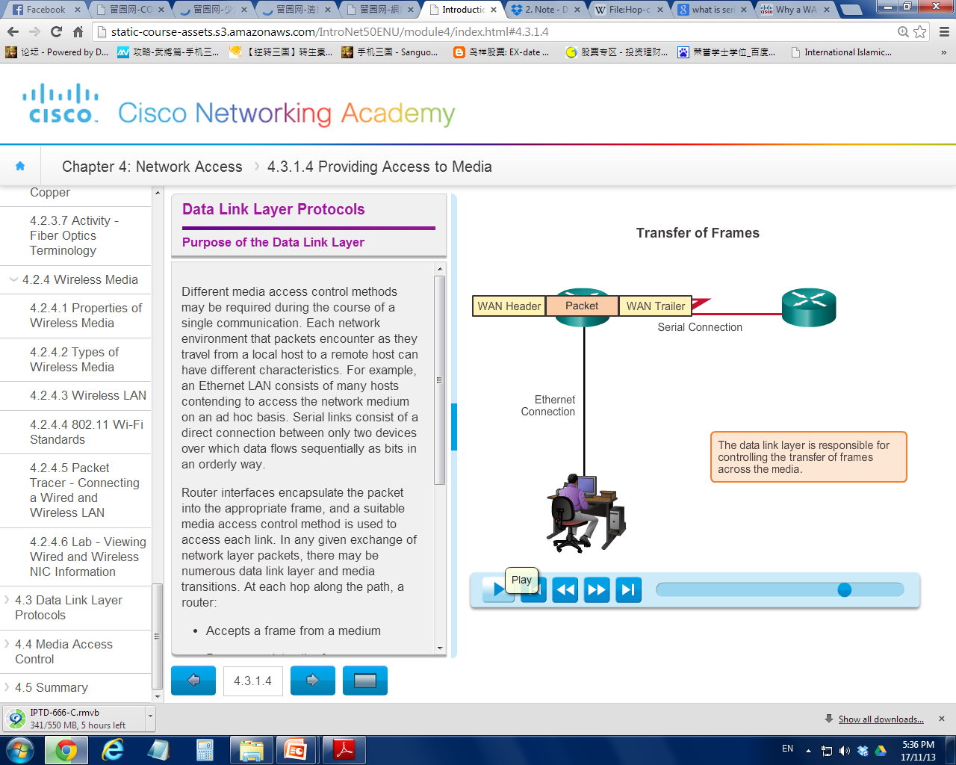
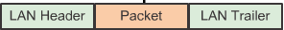
Serial WAN
connection
Different media use different protocols
Protocol governs how to format a frame for use on different media
Ethernet LAN
connection

Slide 13
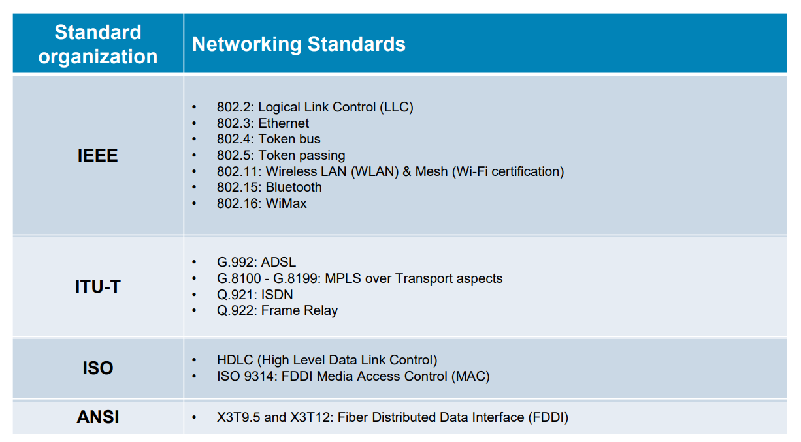
Protocols used in Data Link Layer
v

Slide 14
Cont’d…
The technique used for getting the frame on and off media is called the media access control method.
The media access control methods define:
How nodes transmit frames in diversify network environments
How network devices share and gain access the network media

Slide 15
Cont’d…
The media access control methods used are depending on:
Network Topology → How the networks connections appears to the data link layer (logical topology)
Media sharing → sharing / not sharing the media?

Slide 16
4.2.1 Network Topology
Physical topology → refers to physical arrangement of nodes and the physical connection between them.
Logical topology → refers to how nodes transfer frame from one node to another. Virtual connection of devices using device interfaces and IP addressing scheme.
The logical topology determines the type of network framing and media access control protocol to be used.

Slide 17
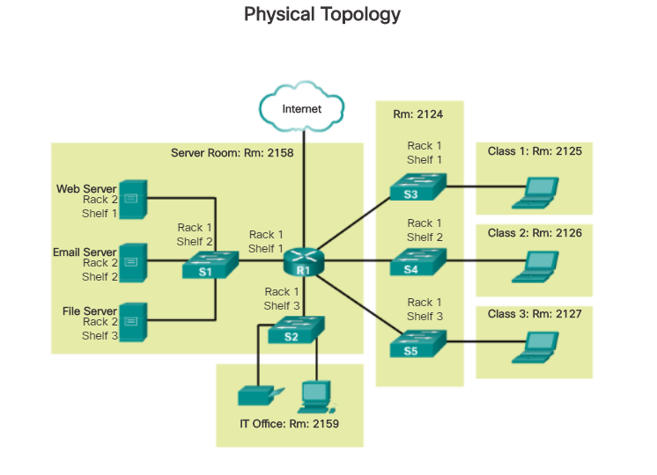

Slide 18
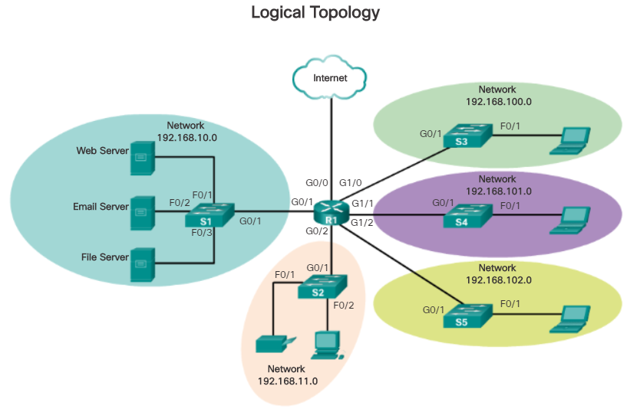

Slide 19
Cont’d…
Physical topologies typically used in networks are:
Point-to-Point (WAN)
A topology where two nodes are connected directly together
All frames on the media can only travel to or from the two nodes
Multi-Access (LAN)
Each node is connected to a single cable, by the help of interface connectors.
This central cable is the backbone of the network and is known as the bus
Rings (LAN)
A ring topology is a bus topology in a closed loop
Data travels around the ring in one direction

Slide 20
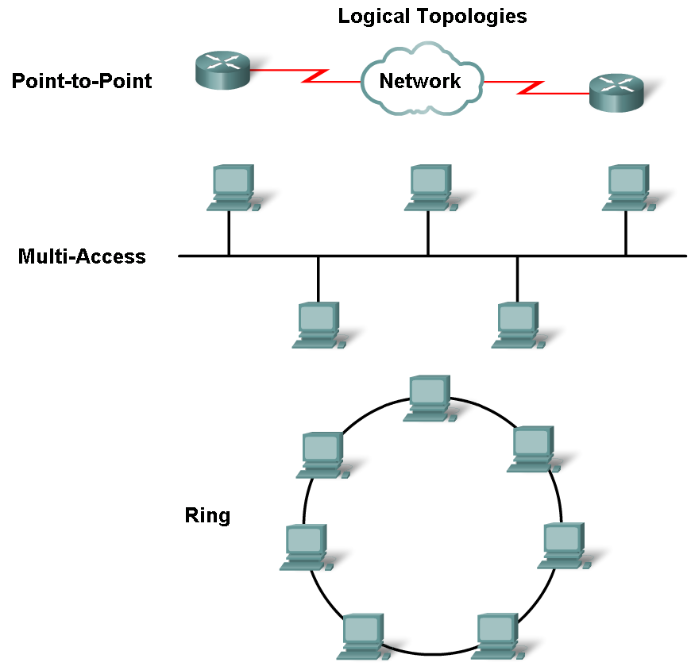

Slide 21
4.2.2 Half / Full Duplex Communication
In point-to-point topology, data can be moved in one of the two ways below:
Half-Duplex communication
Both devices can both transmit and receive on a shared media but cannot do so simultaneously.
Full-Duplex communication
Both devices can transmit and receive on a shared media at the same time.

Slide 22
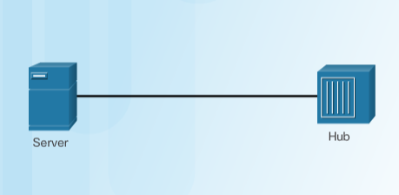
Half-duplex communication
Ethernet hub operates in half-duplex mode

Slide 23
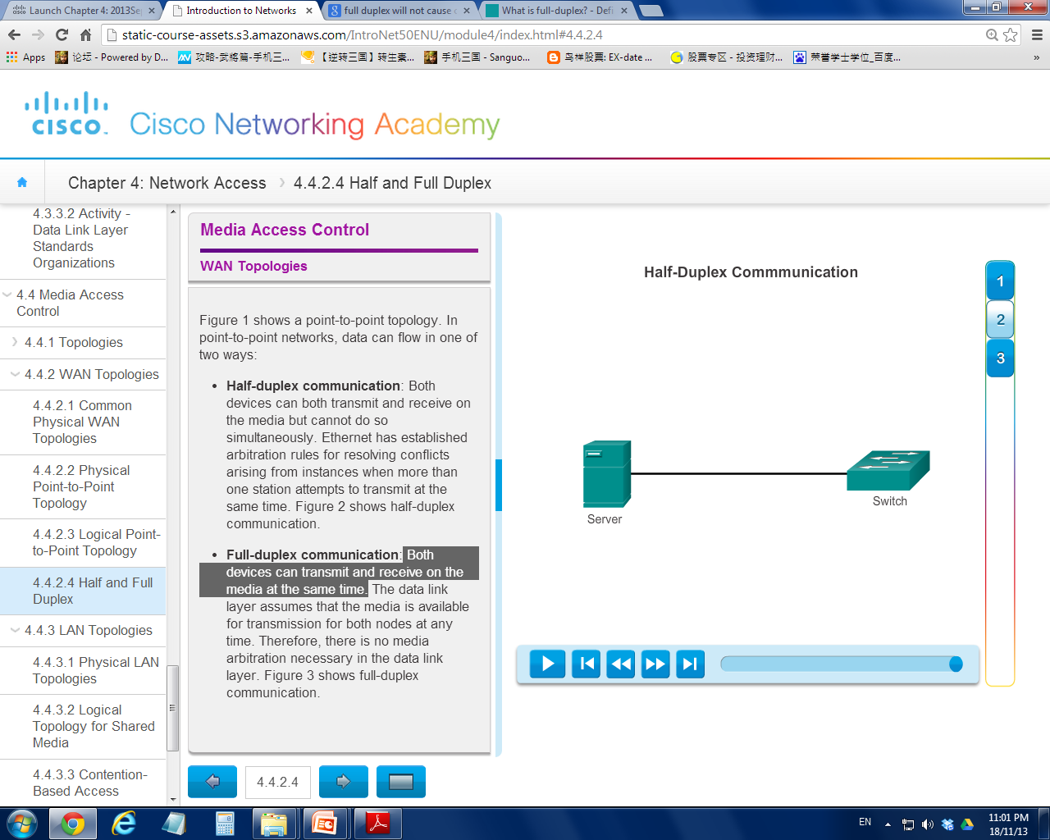
Full-duplex communication
Ethernet switch operates in full-duplex mode

Slide 24
4.2.3 Media Access Control Methods
Some network topologies share a common medium with multiple nodes → multi-access networks
Ethernet LANs and WLANs are examples of a multi-access network.
Some multi-access networks require rules to govern how devices share the physical media. There are two basic access control methods for shared media:
Contention-based access
Controlled-based access

Slide 25
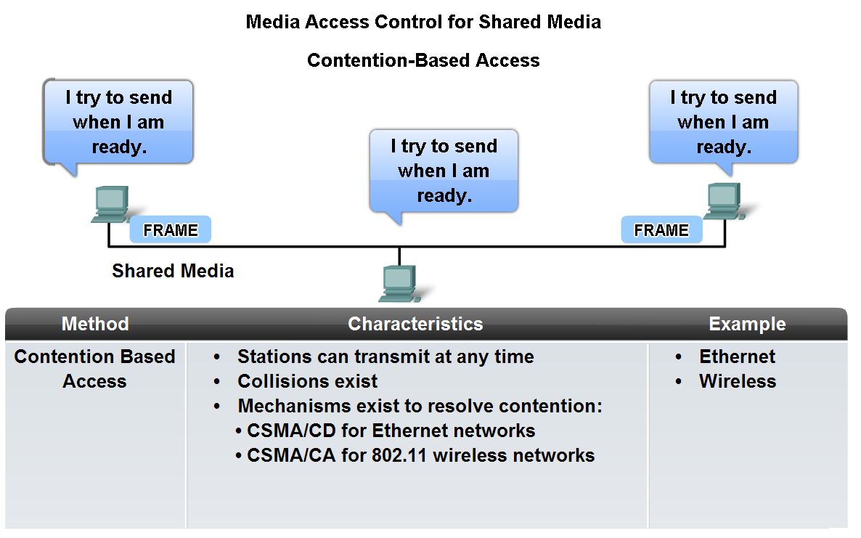
Contention-based Access
compete

Slide 26
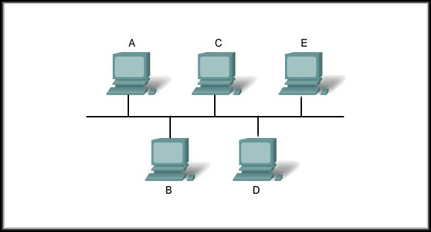
Carrier Sense Multiple Access/Collision Detection (CSMA/CD)
A sends to E
Check for other transmissions
Media is available
Transmit
X
X
X
I’ll wait……
Media is NOT available
Check for other transmissions
B needs to send to D

Slide 27
Carrier Sense Multiple Access/Collision Detection (CSMA/CD)
A sends to E
Check for other transmissions
Media is available
Wait & Retransmit
Transmit
X
Backoff
Backoff
Transmit
Wait & Retransmit
Media is available
Check for other transmissions
D sends to B

Slide 28
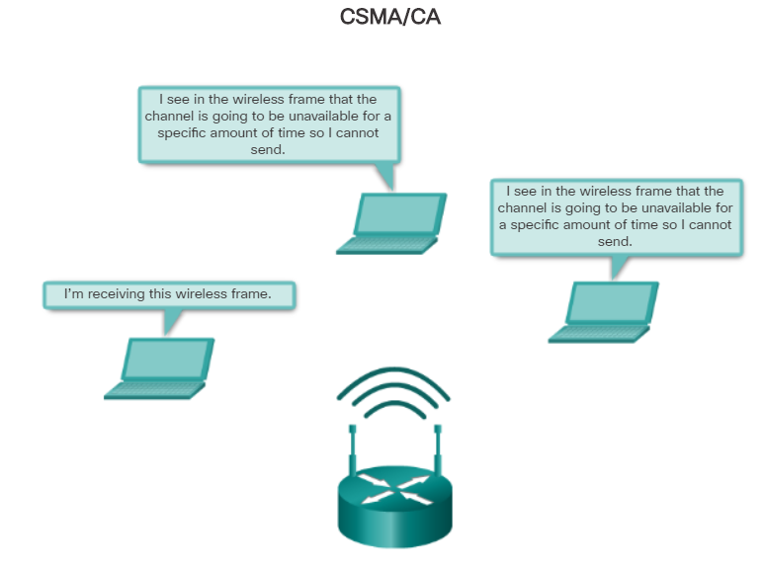
Carrier Sense Multiple Access/Collision Avoidance (CSMA/CA)

Slide 29
CSMA/CD vs CSMA/CA
CSMA/CD deals with transmissions after a collision has occurred
CSMA/CA prevents collisions before they happen.
CSMA/CD is used in wired networks (Ethernet)
CSMA/CA is used in wireless networks (WLAN)
CSMA/CD has also fallen out of favor with modern Ethernet using switch

Slide 30
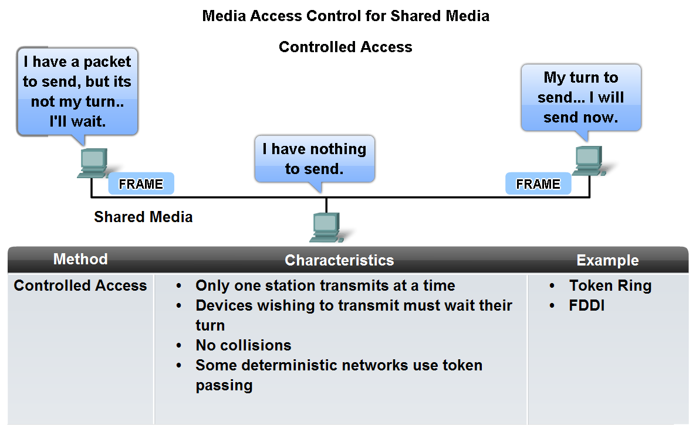
Controlled-based Access

Slide 31
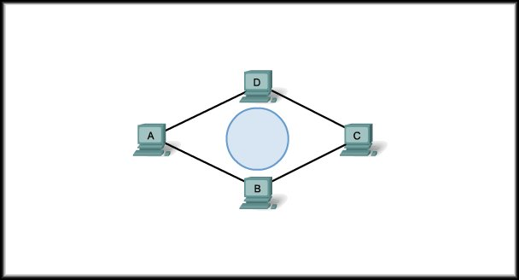
Token Ring
token

Slide 32
Token Passing
Let’s assume A has grabbed the token
Is it for me?
Yes
No
Is it for me?
A sends to D
No
Is it for me?

Slide 33
4.2.4 The Frame Structure
There are many different Data Link Layer protocols (eg. PPP, Token Ring, Ethernet, 802.11 Wireless LAN)
Hence, different protocol will define different frame structure.
No single frame protocol meets the needs of all data transportation across all types of media.

Slide 34
Cont’d…
However, each Data Link Layer protocol is constructed using the same basic format. It’s the contents that differ.
Layer 2 Data Link Frame consists of 3 parts:
Header | Data | Trailer
Frame

Slide 35
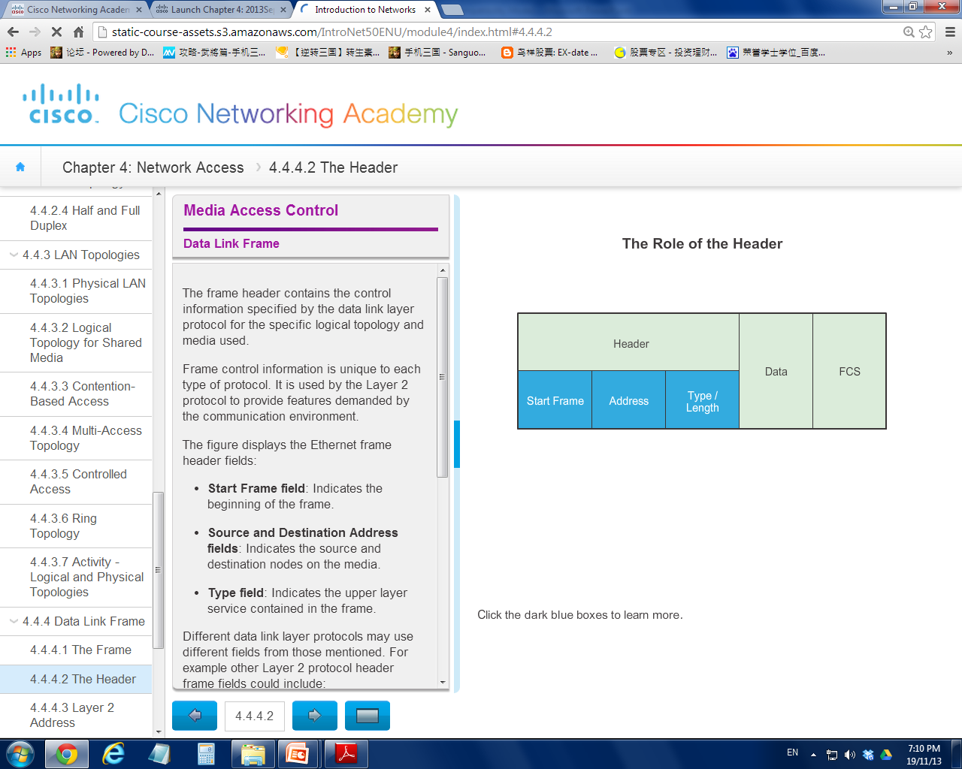
The Header
Header | Data | Trailer
The Frame Header consists of control information that is unique to each protocol used.
Eg. Ethernet frame header fields consist of:
Start Frame field
Source and Destination Address fields
Type field
Header control information
(fields)

Slide 36
Cont’d…
Other protocols may includes fields like:
Priority / Quality of Service field
Logical connection control field
Physical link control field
Flow control field

Slide 37
Addressing: Where the Frame Goes?
The addresses used this layer are referred to as physical addresses.
They are the burned-in MAC addresses of the
network device.
They are only used for local delivery.

Slide 38
Cont’d…
MAC address has no meaning beyond the local network.
If the packet in the frame must pass onto another network segment, the intermediate device - router - will decapsulate original frame, examine the IP address, create a new frame for the packet, and send it onto the new segment.

Slide 39
The Trailer
Data link layer protocols add a trailer to the end of each frame.
The trailer is used to determine if the frame arrived without error (as signals transfer are subject to interference, distortion, or loss)
This process is called error detection

Slide 40
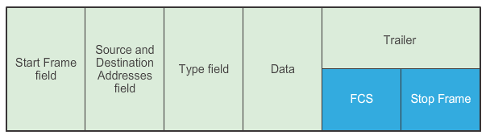
Cont’d…
Header | Data | Trailer
A sender node creates a frame’s content summary known as the cyclic redundancy check (CRC) value and stores in the Frame Check Sequence (FCS) field.
The FCS field is then used for error checking.
Trailer control
information

Slide 41
Cont’d…
The receiving node will check its owns CRC values when a frame arrives.
If CRC values matched, → no error
If CRC values do not matched, → discarded

Slide 42
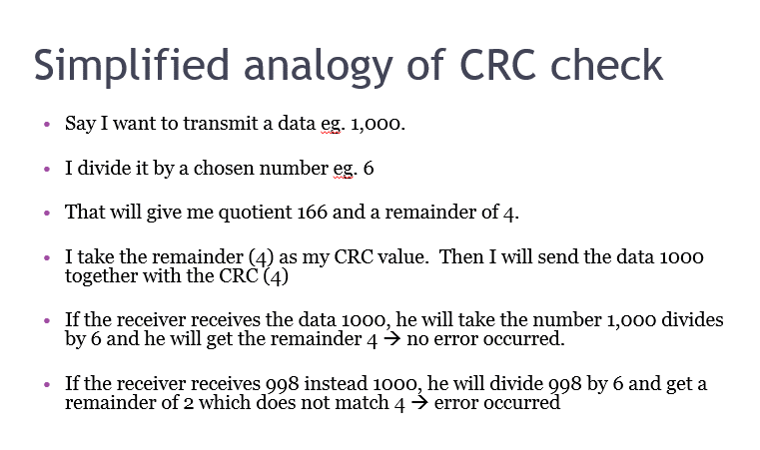

Slide 43
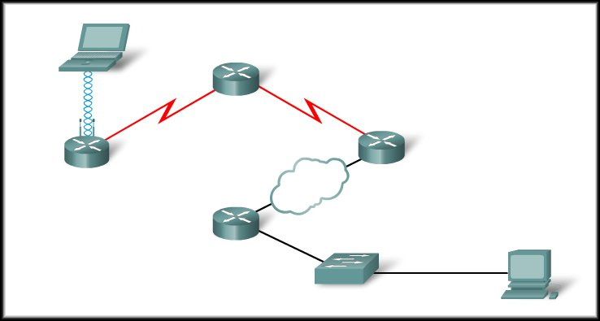





Frame Movements and Changes
Point-to-Point Protocol (PPP)
High Level Data Link Control Protocol (HDLC)
Frame Relay Protocol
Ethernet Protocol

Slide 44
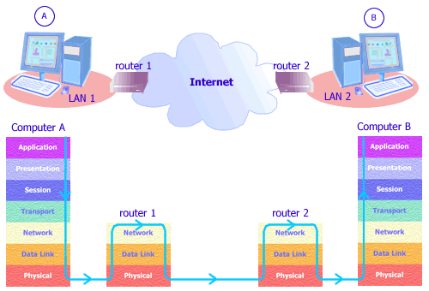

Slide 45
Summary
Roles of Data Link Layer
How Data Link Layer involved in network comm
Different types of Media Access Control (MAC) methods
Network logical and physical topologies
Layer 2 Frame structure

